Slide 1
Death and Dying
Development Across the Lifespan

Slide 2
Death is a universal experience, one that we will all eventually face
Some things that are being explored:
What is death, and what does it mean at different life stages?
How do people face the idea of their own death?
How do survivors react to death?
How can people prepare for and cope with death?

Slide 3
Defining Death: Determining the Point at Which Life Ends
→ FUNCTIONAL DEATH is the absence of a heartbeat and breathing.
NOT as straightforward a definition as it seems!
People can be resuscitated after they have stopped breathing.
People can be kept alive by a machine

Slide 4
Because of the vagueness of what “functional death” is, medical doctors now use brain functioning to determine death
→ BRAIN DEATH, where brain activity is measured, has become the medical measure of death (no possibility of restoring brain function).
There is still some question about using only brain waves as the death definition.
It emphasizes only biology not the qualities that make people human (thinking, feeling, etc.).

Slide 5
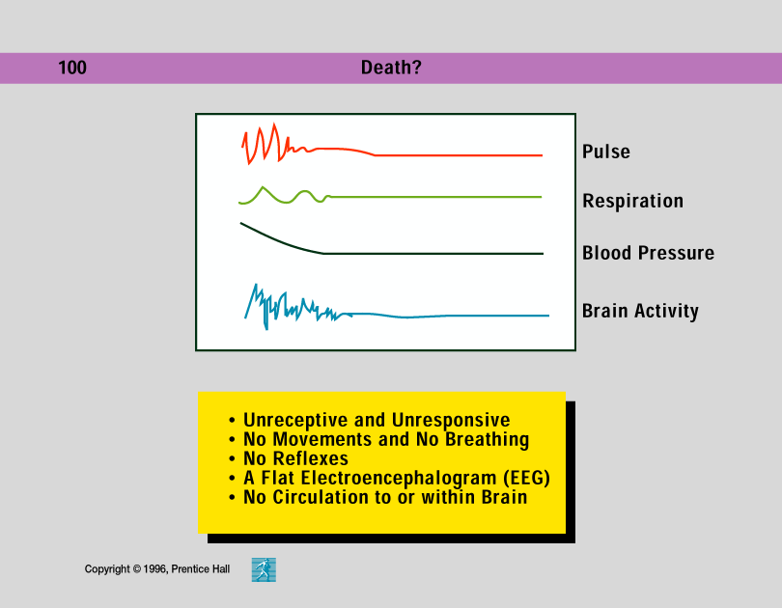

Slide 6
Most people know when they are dying; it is caretakers who tend to have more difficulties communicating about it.
Research shows that physicians usually prefer to avoid telling dying patients that their illnesses are terminal
Not all people want to know the truth about their condition or know they’re dying
Individuals react to death differently, in part due to personality factors
A high general anxiety level has been linked to a higher concern about death
Cultural differences

Slide 7
The Stages of Death: Understanding the Process of Dying
No researcher has had a greater influence on our understanding of death and dying than Elizabeth Kubler-Ross
Her stage theory of death and dying was created from extensive interviews with people that were dying and those that cared for them
Elisabeth Kubler-Ross identified five stages of coping with death.

Slide 8
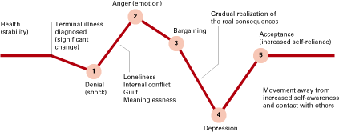
Moving Toward the End of Life
The steps toward death, according to
Elizabeth Kubler Ross (1975)

Slide 9
Kubler-Ross’ 5 stages of death
1) Denial
Denial is resisting the whole idea of death ("No I'm not or she's not").
Denial is a form of defense mechanism to allow one to absorb difficult information at one's own pace

Slide 10
2) Anger
"Why me/her?" "Why not you?"
In this stage people may be very difficult to be around.
3) Bargaining
At this stage individuals are trying to negotiate their way out of the death.
Typically, people try to "make deals" with God.
Sometimes the bargain creates an event or date until which the person can hold on to (such as a grandchild's wedding, or a 100th birthday).

Slide 11
(Kubler-Ross’ 5 stages of death, continued)
4) Depression
The individual at this stage is overwhelmed by a deep sense of loss.
Reactive depression is a type of depression based on what has already occurred, such as loss of dignity, health, etc.
Preparatory depression is the anticipation of future losses, such as the loss of a relationship.

Slide 12
(Kubler-Ross’ 5 stages of death, continued)
5) Acceptance
People are fully aware that death is impending
In this stage individuals near death make peace with death and may want to be left alone.
Persons in this stage are often unemotional and uncommunicative.

Slide 13
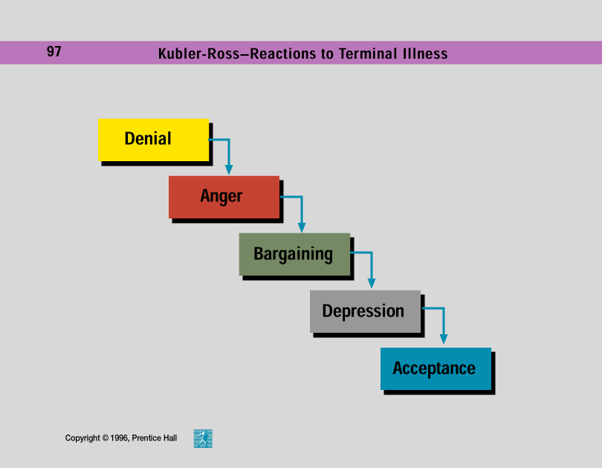

Slide 14
Criticisms of Kubler-Ross's model
The theory does not apply to people who are not sure they are going to die - when the prognosis is ambiguous.
The stages are not universal, nor do people go through them in progression.
Anxiety, especially about pain, is omitted in her stages and this is an important concern for cancer patients.
There are still a lot of differences in peoples' reactions to death related to family, culture, finances, personality, etc.

Slide 15
Choosing the way one dies - people now have choices
→ The letters "DNR" (do not resuscitate) mean that medical personnel should not go to extraordinary or extreme efforts to save the terminally ill patient.
The terms "extraordinary" or "extreme" are difficult to define.
No one likes to make this decision.

Slide 16
To gain more control over decisions regarding their death, increasing numbers of people are signing living wills
LIVING WILLS, legal documents designating what medical treatments people want or do not want if they cannot express their wishes are a method of letting people gain control over their deaths.
Often comas are not covered, since they may be considered "non-terminal".
Some living wills specify a health-care proxy to act as a person's representative in making health-care decisions.

Slide 17
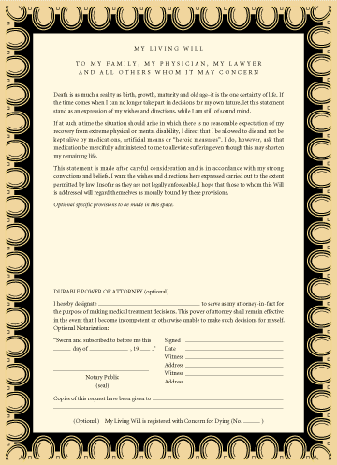
A Living Will

Slide 18
(Choosing death, continued)
→ Assisted suicide is a death in which a person provides the means for a terminally ill patient to commit suicide.
Dr. Jack Kevorkian is best know for this role and has been prosecuted in the U.S.
Laws are more accepting in other countries.
Assisted suicide is one form of EUTHANASIA, the practice of assisting terminally ill people to die more quickly.
Euthanasia is high controversial since it centers on decisions about who should control life.

Slide 19
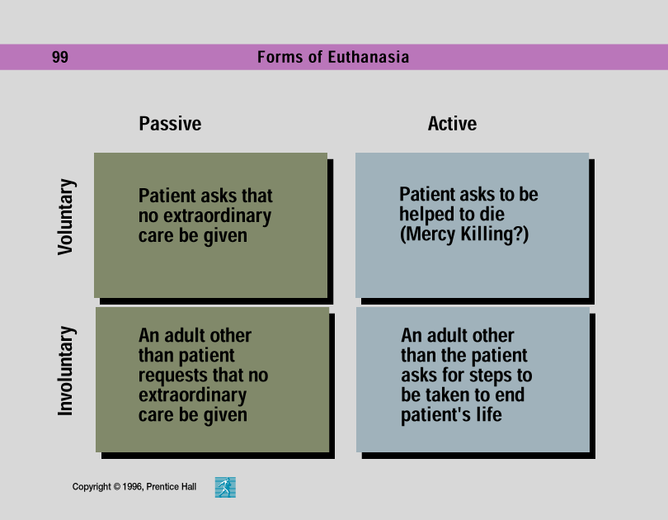

Slide 20
Grief and Bereavement
~ After the death of a loved one, a painful period of adjustment follows, involving bereavement and grief
BEREAVEMENT is the acknowledgment of the objective fact that one has experienced a death.
GRIEF is the emotional response to that loss

Slide 21
There are some general stages people in Western societies go through in adjusting to loss.
The first stage typically entails shock, numbness, disbelief, or outright denial.
Can be beneficial allows a person to function in coping with death (funeral, etc.) without being overwhelmed.
In the second stage, people begin to confront the death and fully realize the extent of their loss.
They fully experience their grief and yearn for the individual.
Eventually the person moves through the pain and depression to a realistic review of the relationship and start to let go.

Slide 22
In the final stage, people reach an accommodation stage where they pick up the pieces of their lives and move on.
Ultimately, most people are able to live new lives, independently from the person who has died
Form new relationships
Become more self reliant and appreciate of life
Not everyone passes through the stages of grief in the the same order or in the exact same way
Personality differences
Relationship with the deceased
Opportunities available for continuing their lives

Slide 23
Differentiating Unhealthy Grief from Normal Grief
~ Differentiating unhealthy grief from healthy grief is difficult and many of the common assumptions are wrong.
There is no time table; many people take longer than 1 year.
Not everyone experiences deep depression.
People who do not show deep initial grief do not necessarily have problems later

Slide 24
The Consequences of Grief and Bereavement
~ Studies show that people experiencing bereavement and grief increase their chances of death as much as 7 times during the first year following the death of a spouse.
At particular risk are men, but remarriage helps lower the risk.
Some factors affecting survivor difficulties are:
Anxious, lonely, dependent people don't cope as well.
If the relationship was ambivalent or dependent, there is poorer adjustment.
Sudden, unprepared-for deaths are more difficult

Slide 25
Death Education
Developmental psychologists and thanatologists have suggested the importance of death education
THANATOLOGISTS, people who study death, suggest that death education be part of everyone's schooling since we are all affected
DEATH EDUCATION includes programs that teach about death dying and grief, and are designed to help all people successfully deal with death and dying
Important because we hide death in Western societies! (removed from everyday life because we are uncomfortable discussing it)

Slide 26
Several types of death education programs have been developed…
Crisis intervention education
Psychologists and therapists provide counseling intervention on an emergency basis (Oklahoma City bombing, for example)
Routine death education
Course work in grade school, colleges becoming increasingly common
Death education for members of the helping professions
Now increasingly included for medical schools, nursing, etc. Most successful programs explore feelings, not just intellectual aspects

Slide 27
Funerals are also recognition of everyone's ultimate mortality and an acceptance of the cycle of life.
Western funeral rituals typically include:
Preparation of the body
A religious ritual
A eulogy
A procession
A wake or Shiva

Slide 28
Military funerals include firing weapons and a flag on the coffin
Some cultures have extreme rituals
Shave their head as a sign of grief, hire mourners to wail, suttee (Hindu practice where widow threw herself on the fire that consumed her husband’s body)
Funeral patterns are differ in different cultures but all have the same function: to mark the endpoint of the life of the person who has died and the starting point for the survivors, from which they can resume their lives.

Slide 29
Study hard for your final exam!

